Slide 1
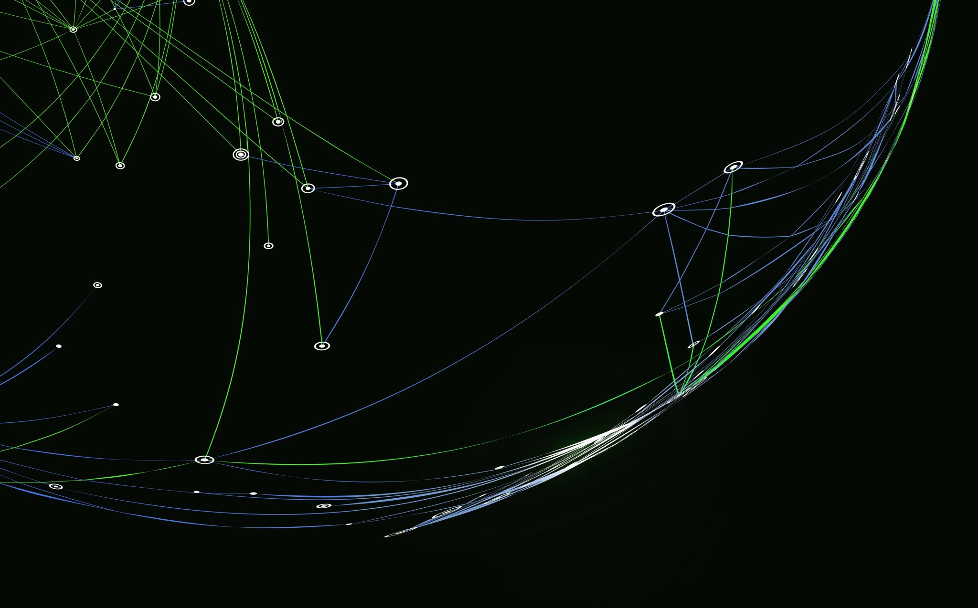
A Comparative Analysis of TensorFlow and PyTorch
ITAI 2376 - Deep Learning in Artificial Intelligence

Slide 2
Introduction
Overview of two major deep learning frameworks: TensorFlow and PyTorch
Objective: Understand strengths, limitations, and ideal use cases
Used VGG16 TensorFlow demo as part of exploration

Slide 3
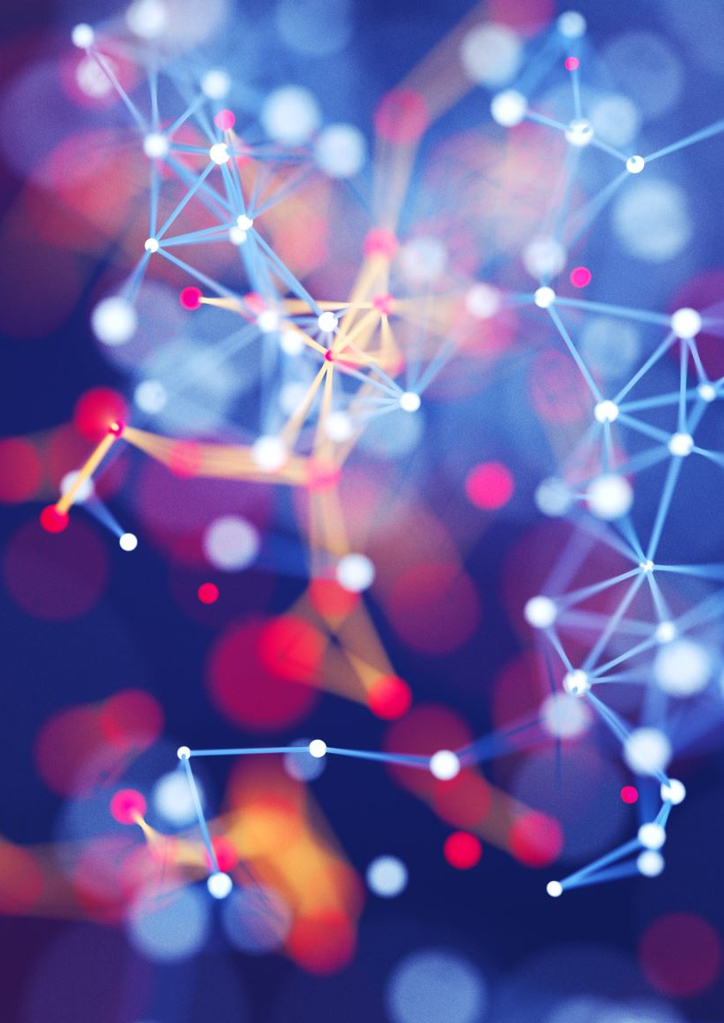
Background
TensorFlow: Developed by Google Brain, released in 2015
PyTorch: Developed by Facebook AI Research, released in 2016
Both widely adopted for machine learning and AI development

Slide 4
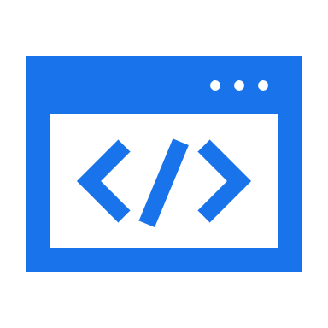
Key Features
TensorFlow: Robust for deployment, mobile and edge support, TensorBoard
PyTorch: Pythonic, dynamic computation graph, easier for research
Both support GPU acceleration and large model training

Slide 5
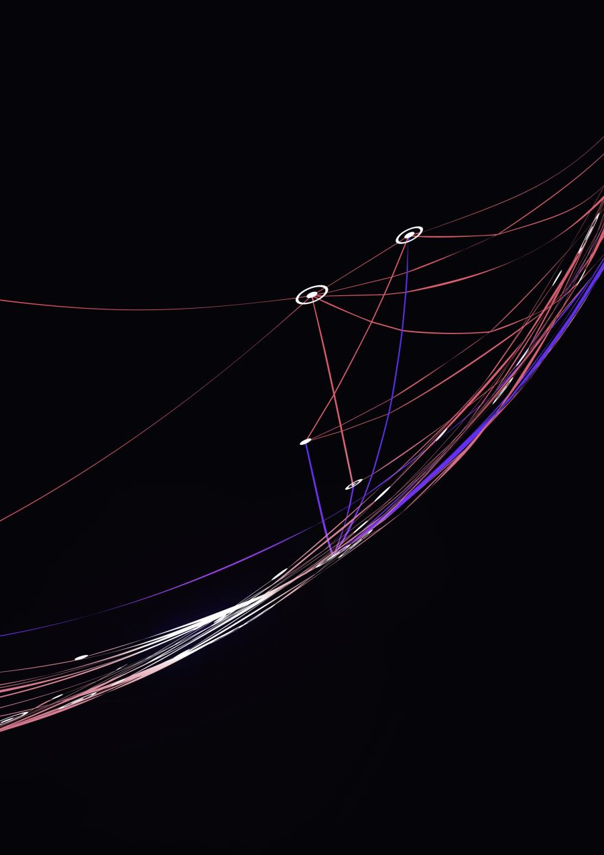
Real-World Applications
TensorFlow: Used by Google, Intel, Twitter for production
PyTorch: Used by Meta, Tesla, OpenAI for R&D
Class demo: TensorFlow + VGG16 for image classification

Slide 6
Comparative Analysis
Usability: PyTorch more intuitive for developers
01
Performance: Comparable, TensorFlow has edge in deployment tools
02
Support: TensorFlow better for enterprise, PyTorch favored in academia
03
Scalability: TensorFlow excels in large production pipelines
04

Slide 7
Conclusion
Both tools are powerful and continue to evolve
Choice depends on project goals: research vs deployment
TensorFlow and PyTorch both essential in modern AI workflows

